Slide 1


Bank Loan Analysis: Unlocking Insights and Reducing Risk
by Varsha Zagade

Slide 2

Introduction
Bank Loan Analysis is the process of evaluating loan data to assess borrower risks and repayment patterns, helping banks make informed lending decisions.
Using Power BI, the analysis involves cleaning and transforming data to distinguish between good and bad loans, while creating interactive dashboards to track loan approvals, repayments, and borrower risks.
It also includes analyzing financial metrics such as the Debt-to-Income (DTI) ratio, loan defaults, and repayment trends.
This analysis aids in identifying high-risk borrowers, reducing loan defaults, and improving financial risk management by providing clear, visual insights that support better lending decisions.

Slide 3
Project Roadmap: From Data to Insights
1
Introduction & Goals
Define the project's purpose, objectives, and methodology.
2
Understanding the Context
Analyze the data structure, key metrics, and tools used.
3
Business Problem
Identify the challenges faced by banks in loan analysis and risk management.
4
Insights & Recommendations
Present findings, draw conclusions, and offer recommendations for improvement.

Slide 4
Project Objectives and Methodology
Project Overview
Primary Objective
Methodology
This project utilizes Power BI to analyze loan data and provide insights to support better lending decisions.
To classify loans as good or bad, assess borrower risks, and reduce loan defaults.
Involves data collection, cleaning, analysis of key metrics, visualization with Power BI dashboards, and providing insights.

Slide 5




Technology Stack
Power BI
Used for cleaning and analyzing the loan dataset.
Gamma
Used to create the presentation of this project.
Microsoft Powerpoint
Used to modify the presentation manually.

Slide 6





Business Problem
High Risk of Loan Defaults
Approving loans for high-risk borrowers can lead to financial losses.
Inconsistent Loan Approval Criteria
Lack of a data-driven approach can lead to inconsistent or subjective loan approval processes.
Inadequate Monitoring of Loan Performance
Early signs of defaults may go unnoticed, making it difficult to take corrective actions.
Limited Insights for Better Decision Making
Without analyzing comprehensive data, banks may lack crucial insights into repayment trends, borrower behavior, and financial health.

Slide 7
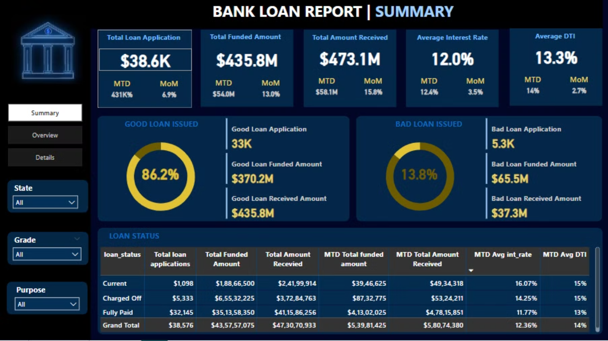
Data Exploration & Visualization

Slide 8
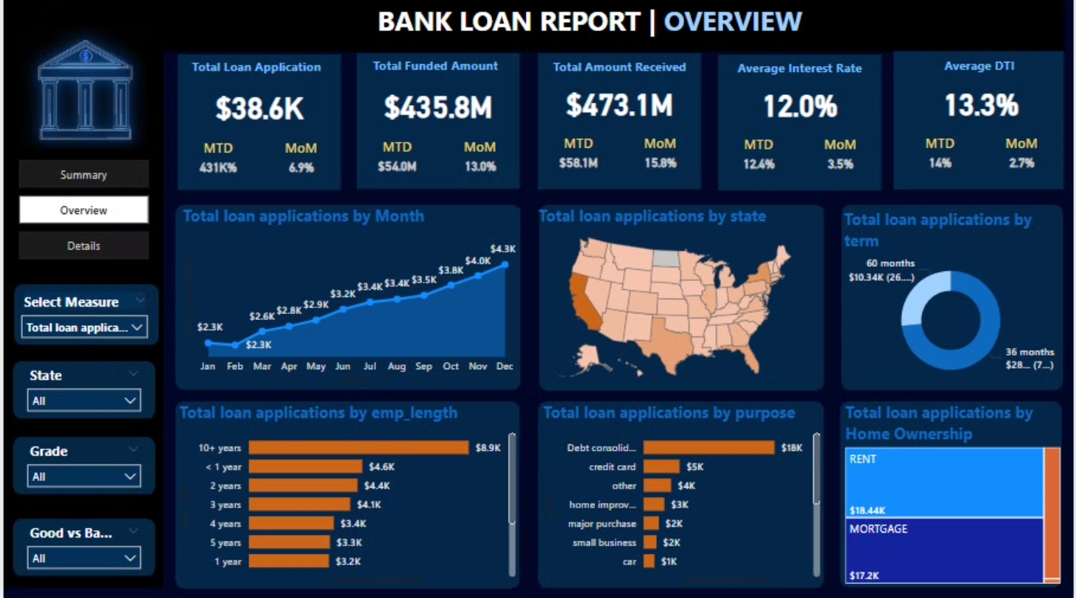

Slide 9
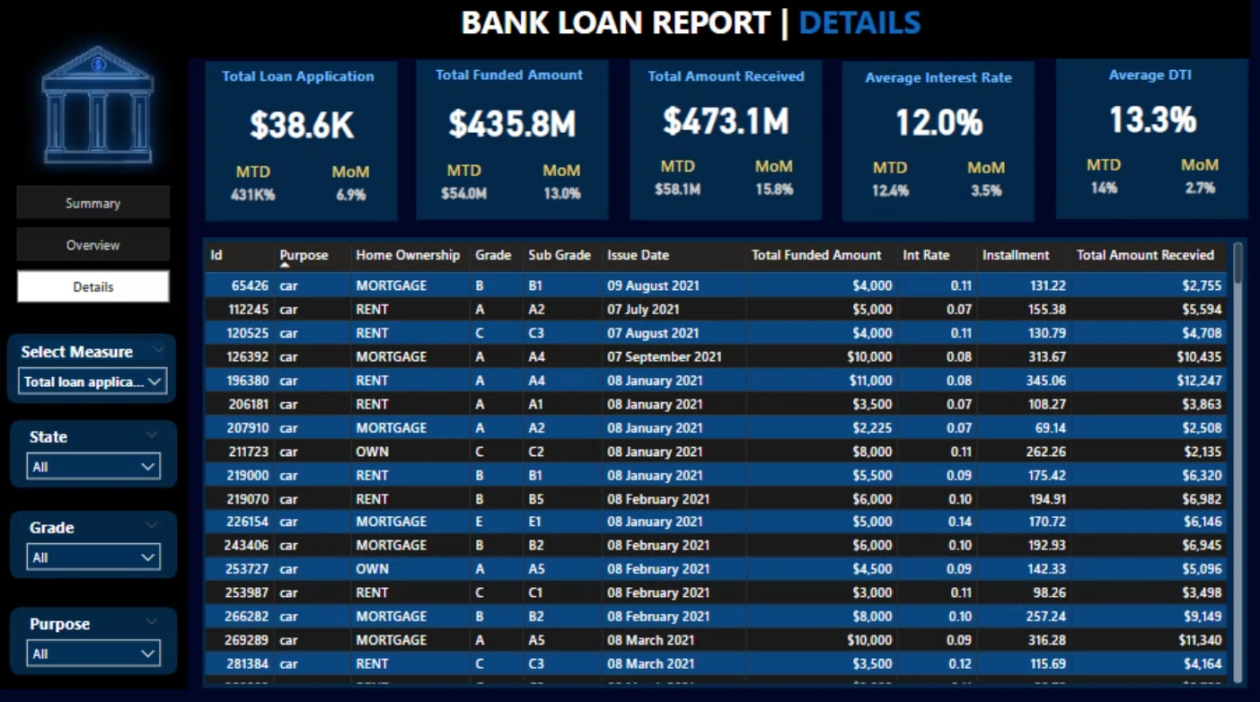

Slide 10

Insights
• Total loan applications for Good Loans ($33,243) were higher than Bad Loans ($5,333).
• Good Loans accounted for 86.18% of total loan applications.
• December had the highest loan applications ($4,314), while February had the lowest ($2,279). December’s applications were 89.29% higher than February’s.
• Borrowers with 10+ years of experience accounted for 22.99% of total loan applications.
• Across all 11 employment categories, loan applications ranged from $1,255 to $8,870.
• The majority of loan applications were from California (CA) state with a total of $6,894.
• A total of $18,214 loan applications were for Debt Consolidation.

Slide 11
Conclusion & Recommendations
Conclusion
Actionable Recommendations
This Bank Loan analysis helps track loan applications, repayments, and borrower risks using Power BI. By analyzing key metrics like interest rates and debt-to-income ratios, banks can identify high-risk borrowers, reduce loan defaults, and improve decision-making. Interactive dashboards provide clear insights, enabling better risk management and smarter lending strategies.
Based on the insights, banks can develop more effective risk assessment strategies, refine loan approval criteria, and improve loan monitoring practices to optimize lending decisions and minimize defaults.

Slide 12

Thank you

